Slide 1
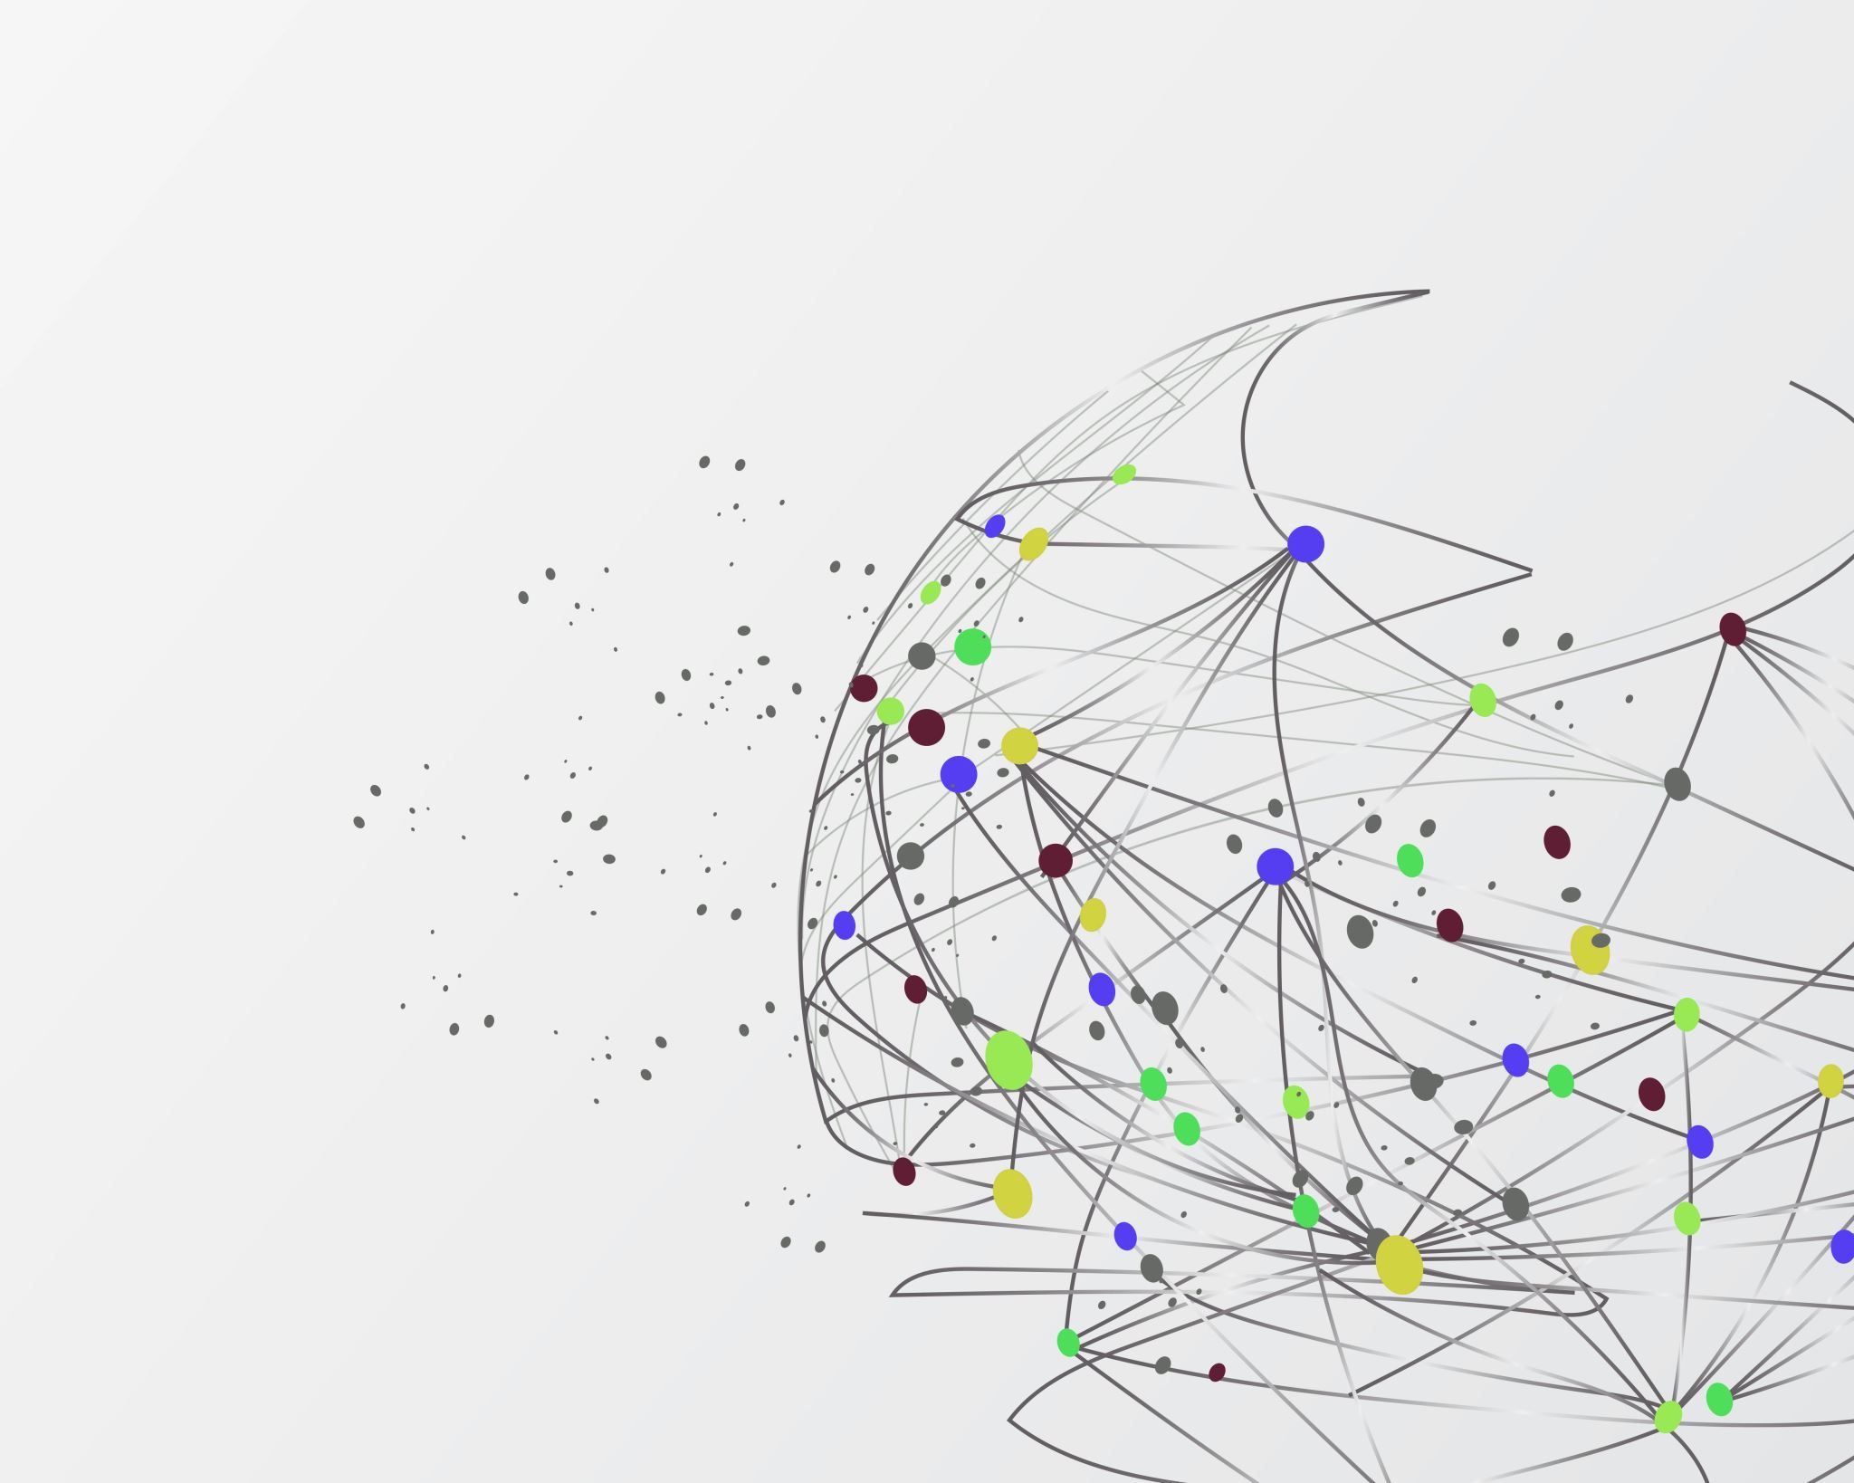
Bachelor thesis system design
Autor
Adam Lewiński

Slide 2
Step 1: ETL Pipeline
Download data [E]
Extract data [E]
Create standardized wide-long format [T+L]
End of this phase: 24.01.2024

Slide 3
Standardized wide-long format
DEPENDENT_VARIABLE | VALUE | TIME | EXO_1 | EXO_2
PM10 | 12.1 | yyyy-mm-dd HH | XX | XX
PM2.5
PM1
PM10

Slide 4
Step 2: Data Preparation
VIF Task [NP]
Manual Selection [NP]
More advanced feature engineering tasks [NP]

Slide 5
Step 3: Model Training
Implement splitters
Forecasting Pipeline [27.01.2024]
Implement Multiplexing [27.01.2024]
Data postprocesor [27.01.2024]

Slide 6
Step 4: Model Evaluation
Data Evaluator [28.01.2024]
Time Evaluator [28.01.2024]

Slide 7
Step 5: Tuner
Forecaster’s tuner [3.02.2024]
Methodology tuner [4.02.2024]
Data preparation tuner [NP]
High Level tuner

Slide 8
Forecaster’s tuner
Build base of models – n models
Select strategy – 2-3 strategies
If Multiplex – select splitter – n splitters
If Multiplex – select scoring – n scorings

Slide 9
Step 6: Publisher
Pipeline Executor [10.02.2024]
Map builder [10.02/2024]

Slide 10
Writing – [11.02 – 21.02]

